Slide 1
UNIT 3:
AT HOME
Getting stated - Listen

Slide 2
NEW WORDS
- chore (n): công việc nhà = housework
- frying-pan (n): cái chảo
- green pepper (n): ớt xanh
- ham (n): thịt đùi heo, thịt giăm-bông
- garlic (n): tỏi
- pea(s) (n): đậu Hà-lan
- teaspoon (n): thìa cà phê
- yummy (adj.): ngon tuyệt

Slide 3
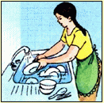
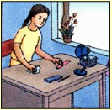
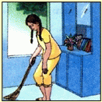
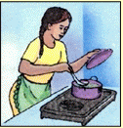
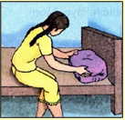
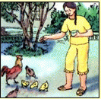
Getting started
washing dishes
tidying up
What chores do you often
do at home?
sweeping the floor
cooking
making the bed
feeding the chickens

Slide 4
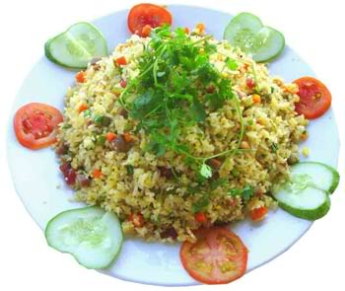
How to cook “Special Chinese Fried Rice”

Slide 5
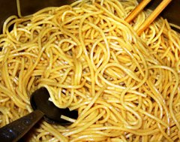
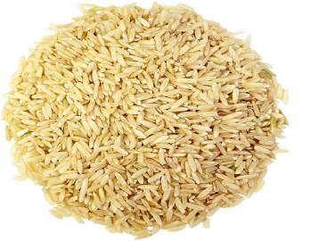
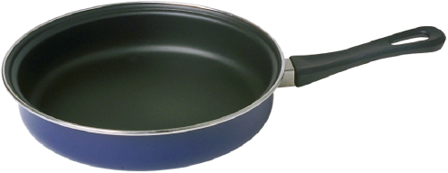
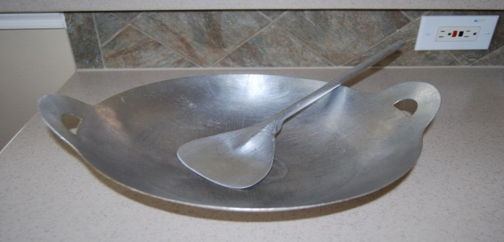
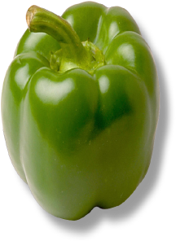
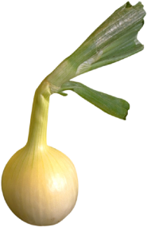
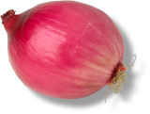
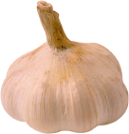
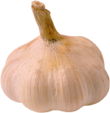
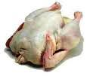
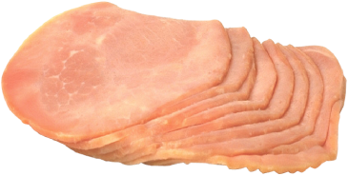
Listen to the tape, then check the right item
a)
b)
c)
d)

Slide 6
Listen and fill in the missing words
Lan:
Can I help you cook dinner, Mom? :
Sure. You can cook the “Special Chinese
Fried Rice” for me. Use …..……......….., please.
O.K. How much oil do I put in?
Just a little. Wait until it’s hot and then fry
………… and ………………………………..
Do I put …………….. and ……………….. now?
Yes. And you can put ………...... and a teaspoon
of salt in.
Yummy! It smells delicious.
Mrs. Tu:
1
Lan:
Mrs. Tu:
2
3
Lan:
4
5
Mrs. Tu:
6
Lan:

Slide 7
LISTEN
Lan:
Can I help you cook dinner, Mom? :
Sure. You can cook the “Special Chinese
Fried Rice” for me. Use …..……......….., please.
O.K. How much oil do I put in?
Just a little. Wait until it’s hot and then fry
………… and ………………………………..
Do I put …………….. and ……………….. now?
Yes. And you can put ………...... and a teaspoon
of salt in.
Yummy! It smells delicious.
Mrs. Tu:
1
the big pan
Lan:
Mrs. Tu:
the garlic
2
the green peppers
3
Lan:
the ham
4
the peas
5
Mrs. Tu:
6
the rice
Lan:

Slide 8
How to cook “Special Chinese Fried Rice”
Put the statements in the correct order:
Put a little oil into the pan.
Wait until it’s hot.
Fry garlic and green peppers.
Put rice in.
Use a big pan.
Add ham and peas.
2
3
4
6
1
5

Slide 9
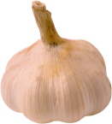
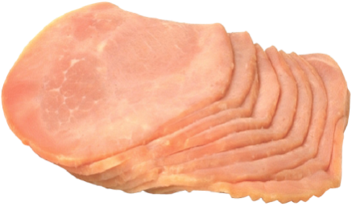
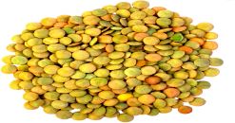
How to make
“Special Chinese Fried Rice

Slide 10
Homework
- learn new words by heart
- Prepare unit 3 : Read (page 31 text book)

Slide 11
THANKS FOR YOUR ATTENDANCE !
GOODBYE.

